Slide 1


covid-19 data analysis

Slide 2
INTRODUCTION OF TEAM MEMBERS
DHARSSINI K - 20 33 009
TANUSHREE R - 20 33 036
DEPARTMENT: M.Sc., DCS (1st year)
Guide mentor:
DR.D.MANJU
ASSISTANT PROFESSOR, DEPARTMENT OF COMPUTING.

Slide 3
introduction to covid 19
On 31st December 2019, in the city of Wuhan (CHINA), a cluster of cases of pneumonia of unknown cause was reported to World Health Organisation.
In January 2020, a previously unknown new virus was identified, subsequently named 2019 novel corona virus. WHO has declared the COVID-19 as a pandemic.
A pandemic is defined as disease spread over a wide range of geographical area and that has affected high proportion of the population.

Slide 4
PROBLEM STATEMENT covid 19 data analysis
Through the data analysis of cases one can analyze how countries all over the world are doing in terms of controlling the pandemic. Analyzing data leads to adapt the prevention model of the countries that are doing great in terms of lowering the graph.
Predictions are made with the dataset available to the individual/country/organisations, thus helping them to decide how far they are able to control the pandemic or up to how much extent they should guide preventive measures.

Slide 5

objective
Through this project, a step towards helping people to understand the spread and predict the minimum & maximum of confirmed, recovered and deaths, correlation and regression of cases on Apr 29 is done.

Slide 6


Functionalities
Maximum number of confirmed cases
Minimum number of death cases
Data analysis in India at Apr 29
Sorting data
Removing using conditional selection
Region wise data
Correlation
Regression
Graph analysis
Summary statistics

Slide 7




Language features
Numpy
Pandas
Seaborn
Matplotlib

Slide 8
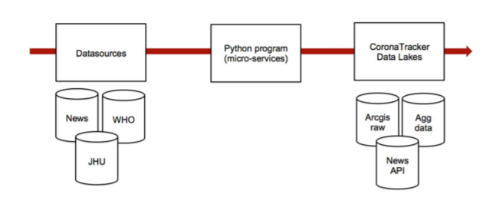
Data source
Type of data: Numerical Data
How data were acquired: From Kaggle
Data format: CSV file
Data Description: The dataset available in this paper is composed of 304 records of metadata about the publications related to COVID-19.

Slide 9
AIM:
To perform data analysis on Covid 19 Dataset using Python

Slide 10
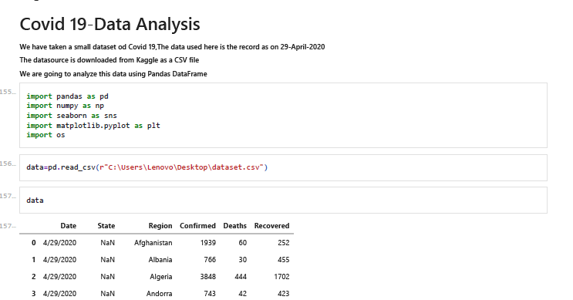
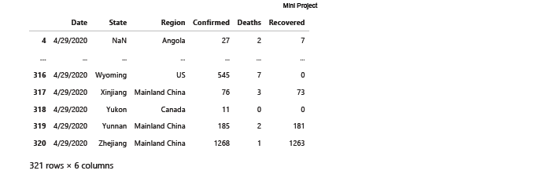
SOURCE CODE:

Slide 11
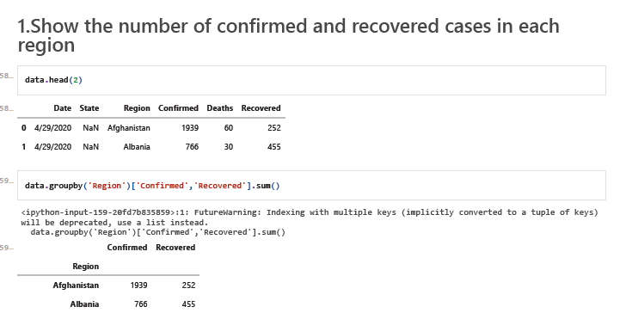
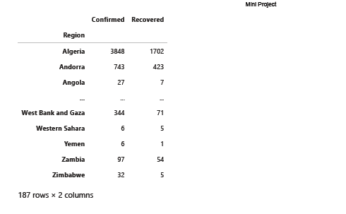

Slide 12
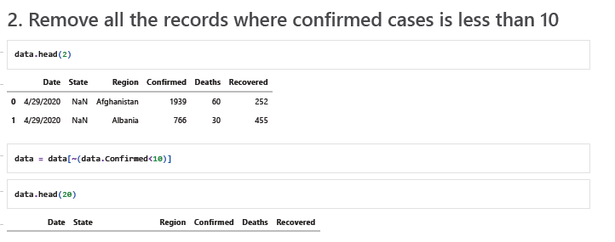
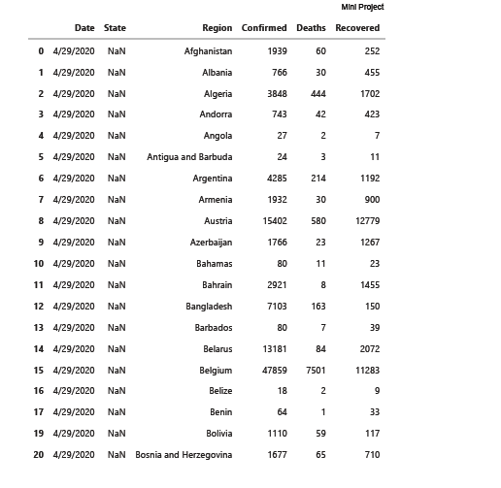

Slide 13
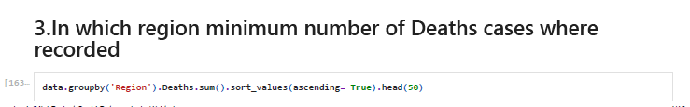
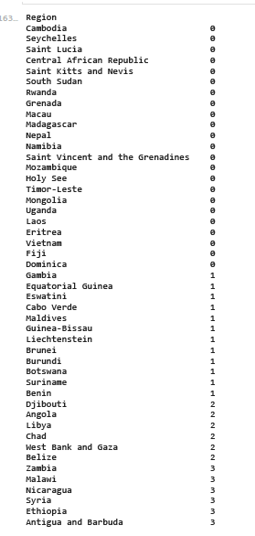


Slide 14
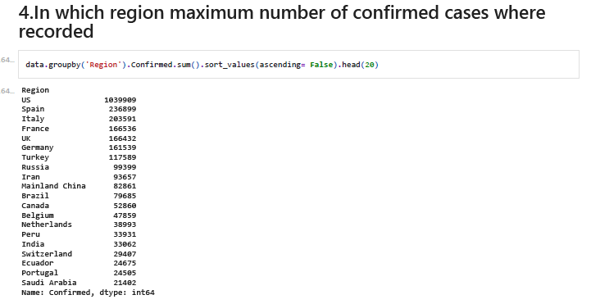

Slide 15
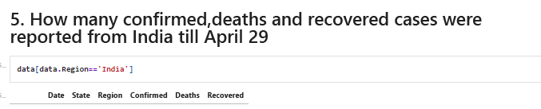


Slide 16
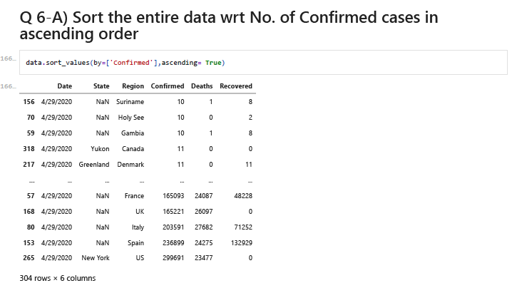

Slide 17
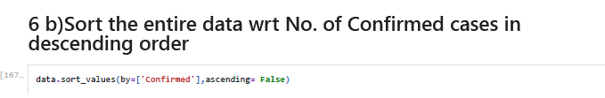
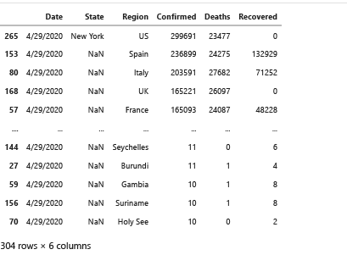

Slide 18
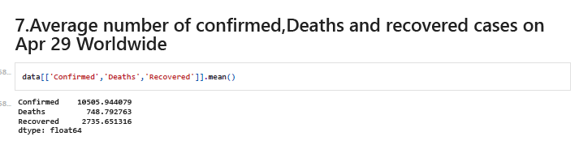

Slide 19
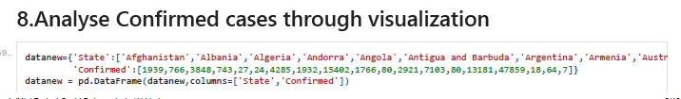
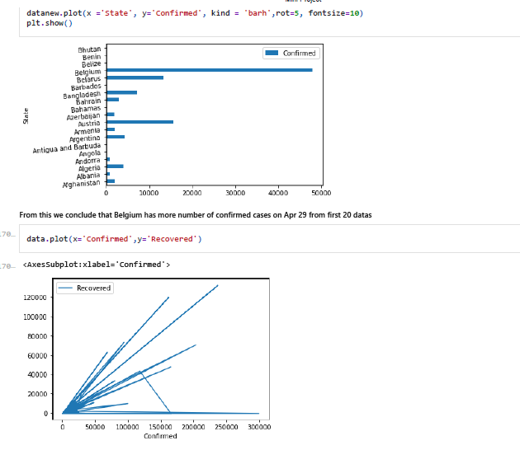

Slide 20
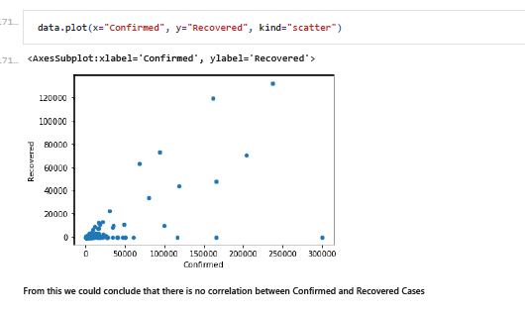

Slide 21
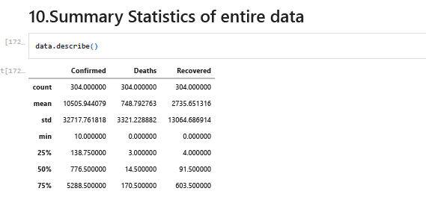


Slide 22
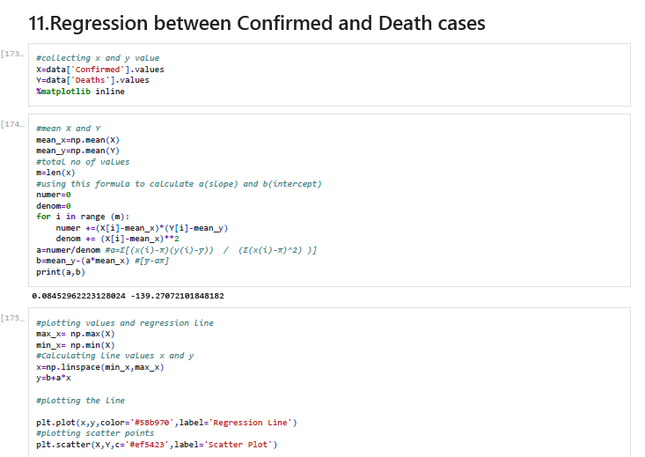

Slide 23
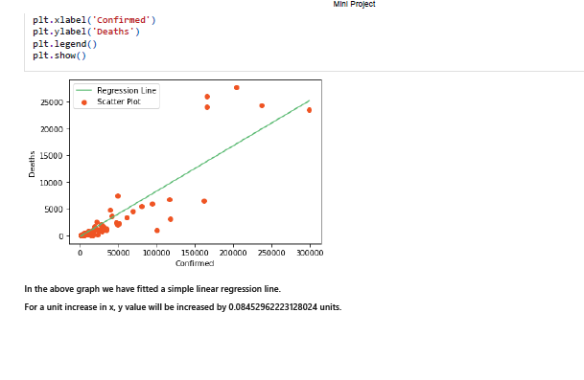

Slide 24
CONCLUSION
Through this project, the analysis on COVID-19 data has been performed successfully.
The analysis of confirmed cases, active cases, recovered cases and deaths are done separately to
give a clear look on how the virus is spreading, which countries are getting affected mostly and
how different countries are recovering.
This brings me to the end of my presentation.

Slide 25
THANK YOU
BELIEVE IN URSELF AND ALL THAT U ARE

